Slide 1
Out of the journal and into social care
Liza Turton
Consultant Social Worker
Notes:
I want you to imagine, imagine you are a frontline social worker. Your day is filled with complex situations, your time being pulled in several directions yet you are making decisions that deeply impact the lives of your clients.
These are the challenges we face in social care.
I still remember the first family I worked with as a newly qualified social worker. There were concerns about domestic abuse, substance misuse, and mental health. I can vividly recall the drive over to their home, running through the referral and my training in my mind. As I knocked on the door, I remember thinking: BUT How am I going to do this? How am I going to address these concerns and also build trust? How do I assess the risks to the children whilst also understanding the issues the parents faced?
And so the complexities of social care began for me.
Fast forward to when I was working in the adult safeguarding team. On this particular day, I was on ‘duty,’ meaning I dealt with all referrals received that day, and decisions had to be made within 24 hours. I was already juggling multiple referrals, but I was starting to feel like I was reaching that ‘in control’ phase – where I’d formulated a plan for all referrals.
But just as I’m feeling confident, another four referrals drop into my inbox. I’m reading through the referrals, prioritizing as I go along. Two of them jump out as requiring immediate action. I’m crossing my fingers, hoping that the public protection unit are waiting for my call, because we need to move fast.
This is the reality of safeguarding—where complex decisions have to be made quickly, often with incomplete information. It’s intense, it’s urgent, and every decision is important. As a practitioner I felt the research base gave me confidence to make these types of decisions.
Now we know research-informed practice is widely recognized as the gold standard, but embedding it into everyday practice for busy practitioners has always been a challenge.
This is why myself and Rachel Scourfield set out to create a model that makes research-informed practice part of the DNA of social care.
Today, I’ll share the Analytical Map framework of how we can use research in practice to empower both practitioner and client alike.
But first, let me share with you why I became so passionate. A few years ago, I was working as a safeguarding lead coordinator, chairing strategy meetings with a wide range of professionals. In these meetings, our goal was always the same: to create a protection plan that would best support the client we were there to keep safe.
I noticed while other professionals confidently used research to support their recommendations, the social care professionals did not, so when we encountered professional differences (as we do), they did not have the same influence. I would try to tease out the reasoning but it never matched a research-informed plan.
I knew from experience social care workers did not have the same access to research either.
This became frustrating and it sparked my desire to change how we, as social care practitioners, make decisions. I knew that we needed to bridge that gap, to empower our social care workforce to be - just as confident, just as evidence-based, as our colleagues.
This is why Analytical Map was developed - it’s about giving our practitioners the tools they need to make robust decisions.

Slide 2
Implementation model
Phase one
Skills training
Phase two
Case mapping sessions
Phase three
Everyday practice
Phase four
Creating the toolkit and sustaining the culture
Notes:
I was fortunate to obtain an NIHR (National Institute for Health Research) Practice-Based Research Leader’s Award to ‘champion a research culture in adult social care.’
Let me tell you how we did it.
We worked with three pilot teams; the complex disability team, the Neath network team and the occupational health team.
Now imagine yourself as a practitioner in one of those teams.
Maybe you feel excited because you’ve wanted to use research, or you could feel apprehensive or even a little resistant.
You’re not alone one practitioner explained how he wanted to take the journal club to the next level, where others worried it was ‘another task’ to their job.
Or you might be worried, worried that the research base would ‘trump’ all decisions, but this is where the Analytical Map comes in, the process allows you to weigh up information and all the options so that a robust decision can be made.
Let’s introduce you to the four-phases of the framework:
Phase One: Skills Training: Firstly, you will complete training on how to incorporate research into your practice.
Phase Two: Case Mapping Sessions: Next, you attend the case mapping session, where we ‘map out’ the research base to inform the decision-making and intervention, you walk away from that session with research to consider and an action plan.
Phase Three: Everyday Practice: Your supervision is going to change slightly and there will be an expectation that you discuss the research base to explain your decisions.
Phase Four: Sustaining the Culture: And lastly, we knew that to sustain this research culture, practitioners needed the right tools (an to A to Z for practice). So, we developed a toolkit—an easily accessible resource that provides quick access to key research findings and other practice tools.

Slide 3
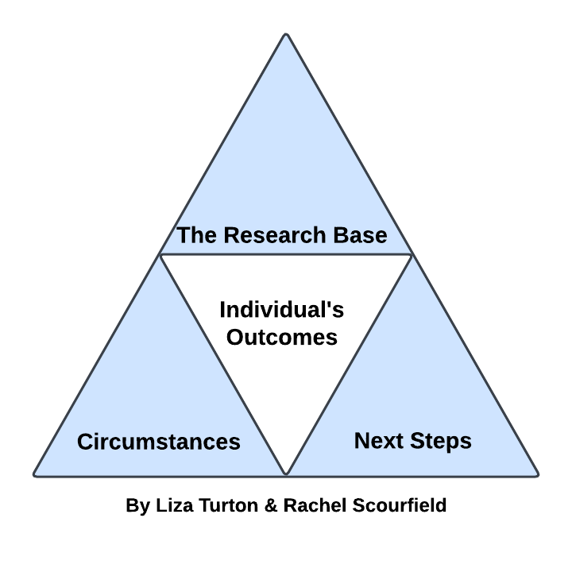
Notes:
Looking more closely at case mapping
So let’s look at the structure of a case mapping session. We unpick a client’s situation together and apply the research base to inform the decision making.
We consider:
The individual's outcomes - What the person would like to happen and their understanding of their situation (this can help us work out what the client needs to know as well as the practitioner)
Their circumstances - which is a summary of what's working well and what we are concerned about. We consider existing strengths as well as complicating factors.
The research base - which includes what evidence base will aid our thinking and decision making
And then we form the next steps – like an action plan for the practitioner
Audience to case map
I would invite you to think about how you could hold your own case mapping session – think about a decision you have to make; break it down, then work out what you need to know to make the decision robust, you then apply the research base to make that decision with confidence.
Impact: What We Learned
So, what did we learn?
One of the most powerful insights came from the practitioners themselves. They shared that integrating research into their practice not only improved outcomes for their clients; it boosted their confidence in decision-making. They felt - more empowered, more knowledgeable, and more assured in their roles.
One social worker shared “I’m waking at 4am worrying about my client” but after attending the case mapping session, she felt she had shared all her concerns and had an action plan going forward – in her words “I’m going to rock this meeting, for my client”.
Client feedback included they felt they had better explanations over their options. One client commented – “I now know what everyone does, I used to get muddled who was who”.
By adopting this model, we were able to show that research doesn’t have to be something distant or disconnected. It can be a daily part of social care.
Research isn’t meant to sit on a shelf or live in a journal. It’s meant to be applied, to help us understand the circumstances and outcomes for clients; to inform our thinking and decision-making.
The pilot teams now hold their own case mapping sessions, we slowly stepped away and created a ‘peer support’ community for those leading the sessions to support each other.
End/conclusion and a call to action
Although trialled in adult social care our plans are to replicate the model for children’s services.
If there’s one thing I’d like you to take away today, it’s that research-informed practice is not an unattainable ideal—it is achievable. We just need to create the right structures, the right support systems, and the right culture to make it happen.
I ask you to join me in championing a research culture. Together, we can drive meaningful change for each other.
I think the question is now - how are we making decisions without the research base? Let’s make research an everyday part of social care, and let’s do it now.

